Slide 1

PowerApps Component Framework Custom Control Development
Aric Levin
Lead Software Architect
Technical Project Manager

Slide 2

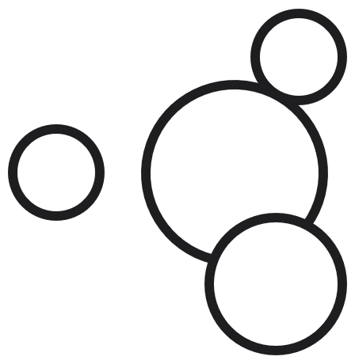

Microsoft Power Platform
The low-code platform that spans Office 365, Azure, Dynamics 365, and standalone applications
Power BI
Business analytics
Power Apps
Application development
Power Automate
Process automation
Power Virtual Agents
Intelligent virtual agents
Data connectors
Common Data Service
AI Builder

Slide 3

What is PCF?
Framework that allows us to build custom components to be used inside of Model-Driven apps
Currently two types of components available:
field
dataset
PCF for Model Driven Apps became General Available (GA) to the public on October 1 2019
Components can only be used in Unified Interface
PCF controls can also be used in Canvas Apps (current in experimental mode, not preview/public)

Slide 4
Prerequisites
Node.js
PowerApps Command Line Interface
Visual Studio
Developer Command Prompt for VS 2017/2019
Developer PowerShell for VS 2019
Optional: Visual Studio Code
Optional: PCF Custom Control Builder plugin from XRM Toolbox

Slide 5
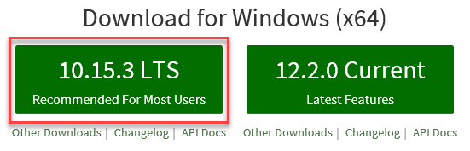
Node.js
Required to develop custom controls for Model-driven apps
http://nodejs.org/en

Slide 6
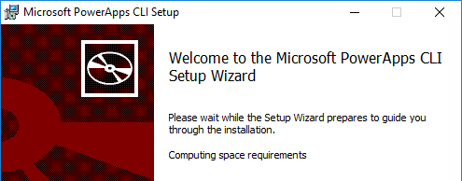
Power Apps Command Line Interface
Required to create PCF Control solutions and deploy to CDS
https://aka.ms/PowerAppsCLI

Slide 7
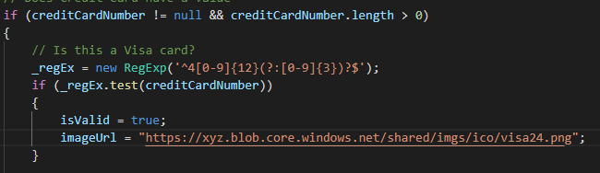
Visual Studio Code
You can use Visual Studio code to create your Power Apps Component Framework controls and simplify development efforts
https://code.visualstudio.com/

Slide 8
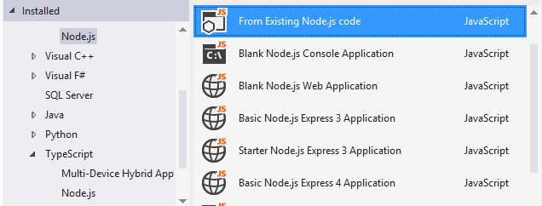
Visual Studio Developer Tools
The Developer Command Prompt or Developer PowerShell for Visual Studio 2017/2019 is required for deployment of PCF custom controls
https://visualstudio.microsoft.com/vs/

Slide 9
Development Lifecycle
Create Required Project files
Install Required components
Development and Testing
Isolated Testing
Continuous Testing (watch)
Solution Creation
Solution Init
Add Reference
MS Build
Deploy Solution

Slide 10
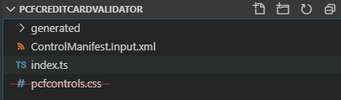
Project Creation
Use the pac pcf init command to create your new project files
pac pcf init --namespace PCFControls --name CreditCardValidator --template field
The values for template will be either field or dataset

Slide 11
Install Dependencies
Use the npm install command to add ALL dependencies to your project
npm install
npm install jquery
npm install @types/jquery
Ability to install all project dependencies or only required project dependencies
Will not add additional code to output, only disk space during development

Slide 12
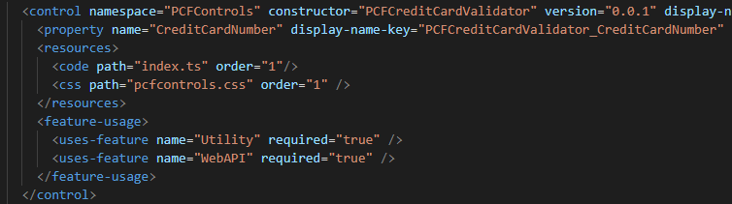
Update Manifest File
Set the properties and resources that make up your project within your manifest file
Property
Enter the properties that will be passed from the Model-Driven app
Resources
Specify which resources make up the control: code, stylesheet, resource files
feature-usage
Specify what features will be used by the app: Utility, WebAPI

Slide 13
Development
Add required code to the Typescript file
variable declaration
Content, notifyOutputChanged, container, HTML elements, event listener, other public variables
init method
Initialization code for typescript variables, binding events and skinning the control
updateView method
Validation and displaying of data back to the user interface
getOutput method
Called prior to control receiving new data
Event handler method
Custom validation code when the event happens

Slide 14
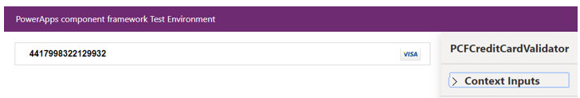
Build and Testing
Compile and test the control using the Test Harness
npm run build
Compile the control files to be tested
npm start
npm start watch for continuous debugging/recompilation/testing

Slide 15
Deploy
Build the solution files and deploy to your CDS environment
Create the solution files and add the required references
pac solution init --publisher-name [NAME] --publisher-prefix [PREFIX]
pac solution add-reference --path [PATH TO PROJECT FILE]
Build the solution files
msbuild /t:restore
Msbuild
Import the packages solution
Configure the solution properties

Slide 16
Demonstration

Slide 17

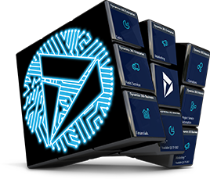
Questions

Slide 18




www.ariclevin.com
www.youtube.com/channel/UCzdg6V5kkjiBufYnvJT4XWQ
github.com/ariclevin
www.linkedin.com/in/ariclevin

Slide 19




Business Applications
Communities
Connect · Learn · Share · Inspire
Join the Microsoft Business Applications Communities where you can connect with peers and experts and earn recognition for your contribution. Get answers to complex questions, learn from engaging discussions, read informative blogs, view webinars, and find product use examples in galleries.
https://community.dynamics.com
https://community.powerbi.com
https://community.powerapps.com
https://community.flow.microsoft.com

